Slide 1

Power Management Dashboard
IoT Analytics
Hunter wu
Notes:
Kick off presentation to Power Management – Energy Usage Analytics
To increase added value of the house
How power management program can increase house value and boost house sales

Slide 2
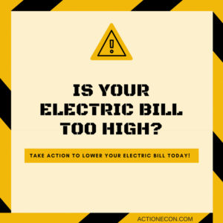
Goals
Power management
Energy efficiency
Power usage analytics
Sub-meters
Home automation
Smart plugs
IoT Analytics
Notes:
Client: regional home developer
Incentive is to decrease the bill
Energy efficiency
Using power management, reading analytics
Implement Sub-metering to monitor appliance individually
Next step
Home automation- smart homes

Slide 3
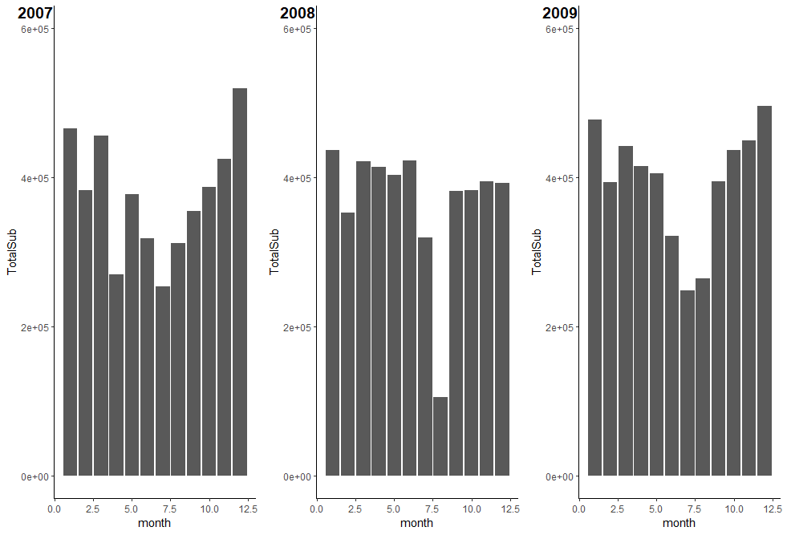

Case Study
South of Paris
One house over 47 months
Sub-metering
Trend
Irregularity
Total usage of 3 meters
Per month over year
Average in watt-hour
Notes:
Temperature control in account of most usage

Slide 4
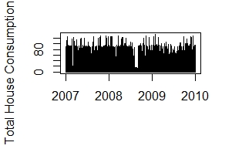
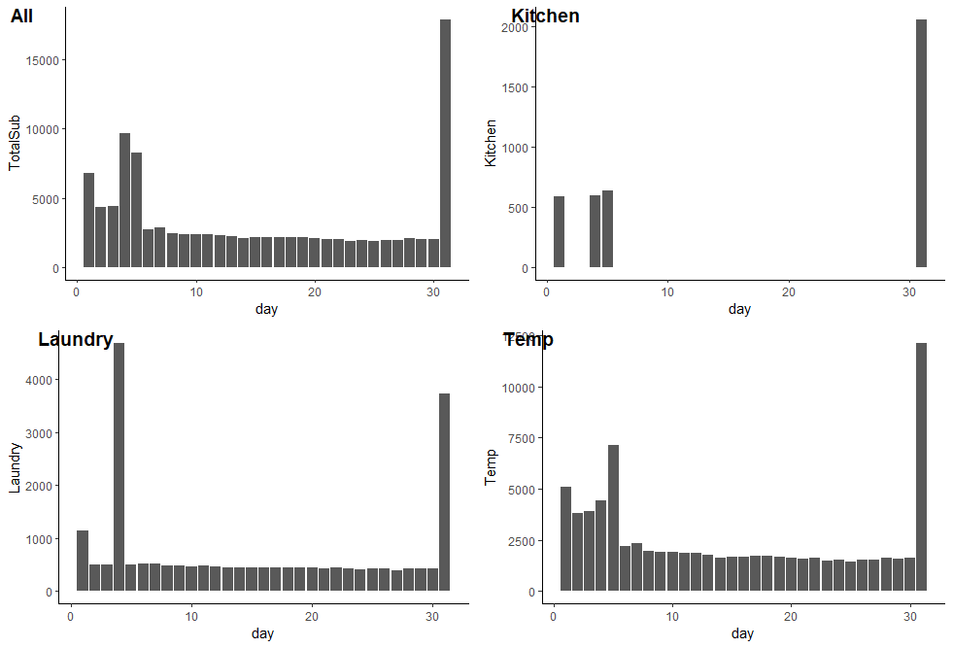
ISSUE 1
Irregular Usage
Low engagement
Set-up Warning system
Aug 2008 per sub meters
Notes:
Irregular usage spotted
After 5 Aug No data- on holiday while irregularity occurred
Holiday/ too busy to check
Explains low engagement in Power management
Warning system should be created
For malfunction/ leakage/ shortage/ danger

Slide 5
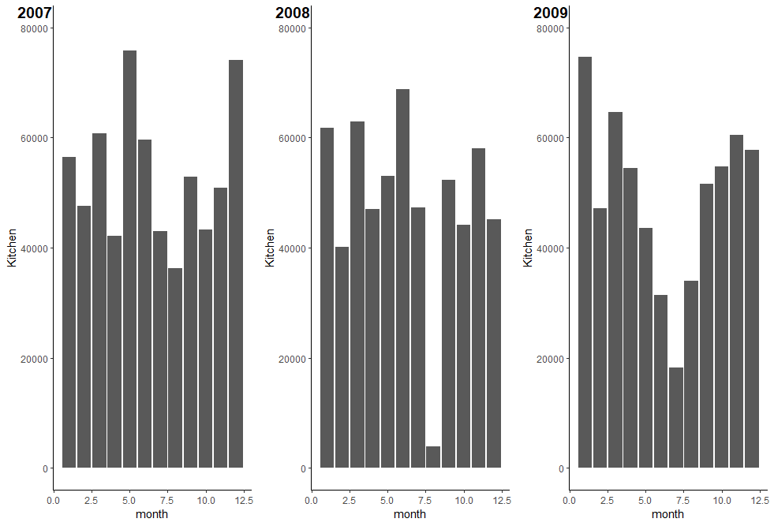
Kitchen
Decrease of Usage
Kitchen usage
Per month over year
Notes:
Downward trend
2018 Aug missing data in Kitchen meter

Slide 6
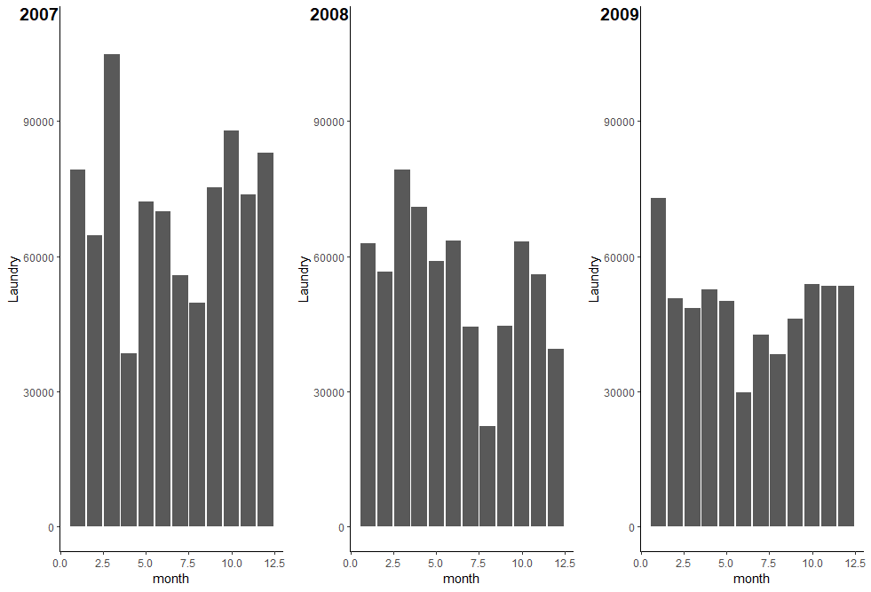
Laundry + Fridge
Decrease of Usage
Laundry usage
Per month over year
Notes:
Fridge !
Laundry room usage is decreasing

Slide 7
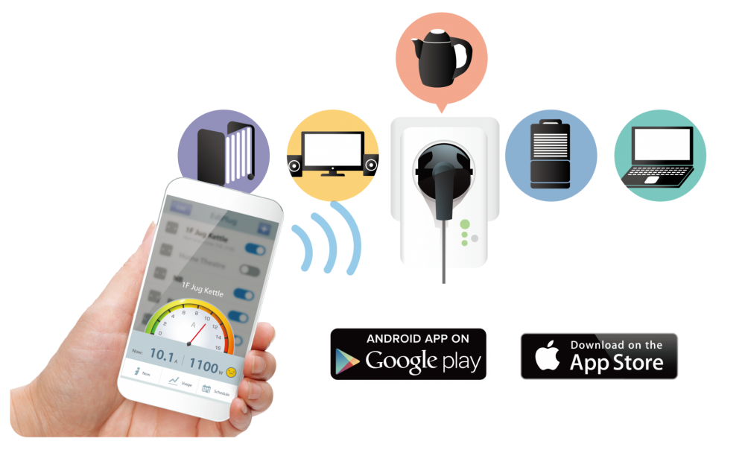
Sub- meter Optimization
ISSUE 2
Fridge in Laundry room
Re-organizing
Per room/ area
Per function
Smart plugs
Notes:
Why fridge reading in laundry room
Separate fridge meter or
Reorganize reading to kitchen
Smart plugs help user control remotely
Pre heat the house/ room
Auto or timer to turn off/ control

Slide 8
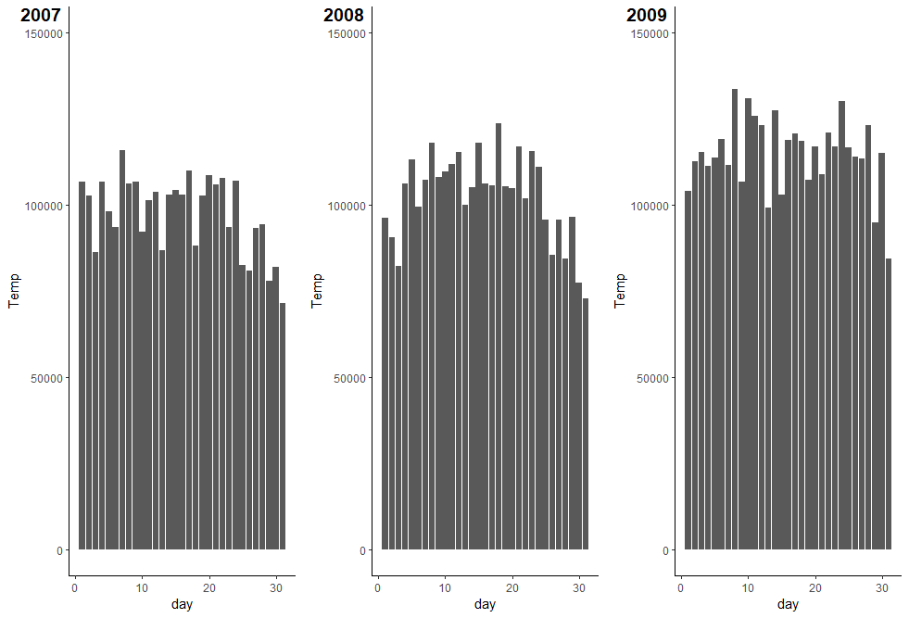
Temperature control
Increase of Usage
Main Usage
Temperature control usage
Per month over year
Notes:
Heating
Air con
Climate change

Slide 9
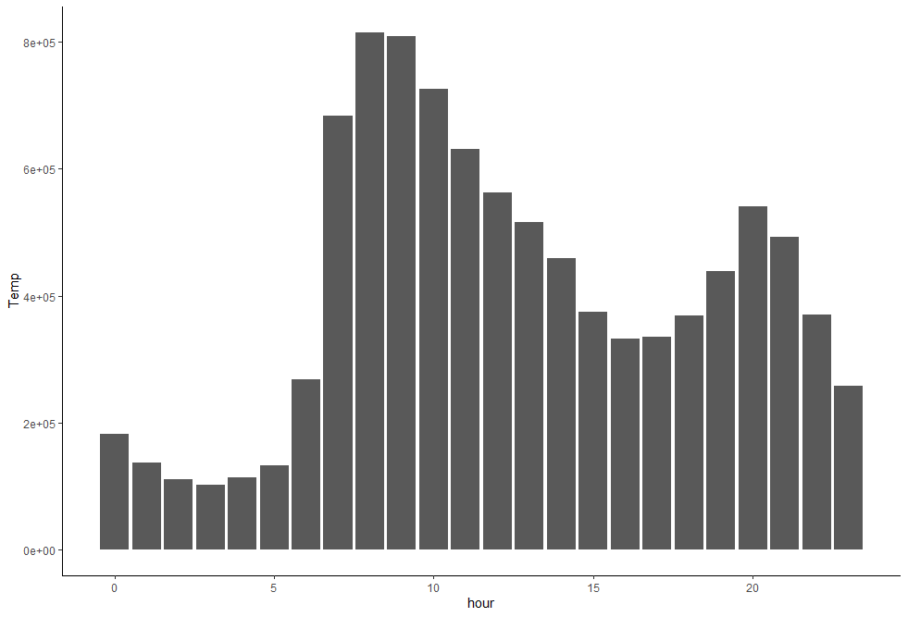
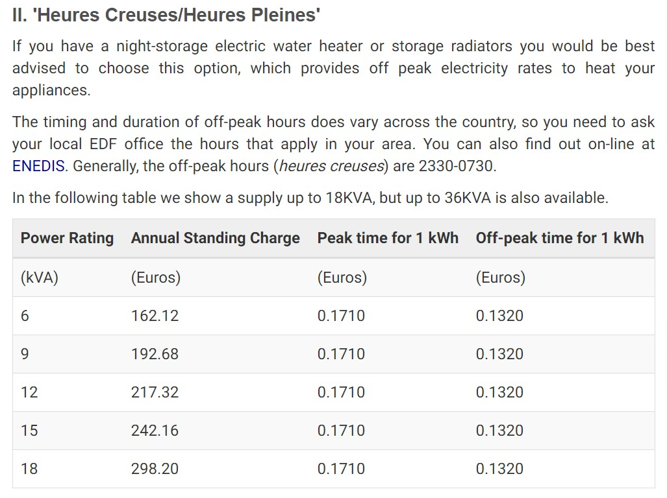
ISSUE 3
Heating in peak hours
30%
More expensive
at peak hour
French Electricity Scheme
Sum of Temp. Control Usage 2007-2009 per hour
Notes:
Global Active power under 6kVA
mean(Global_active_power) 1.08 kVA
Consumer behavior-
Europeans ppl turn off heating during night when sleeping
According to French electricity scheme
If use electric heating system, which in this case should use this scheme on the slide
Peak and off peak hours price
Peak hour price is 30% extra
Use of different schemes-
Offer package and suggestions after monitoring and consultation

Slide 10


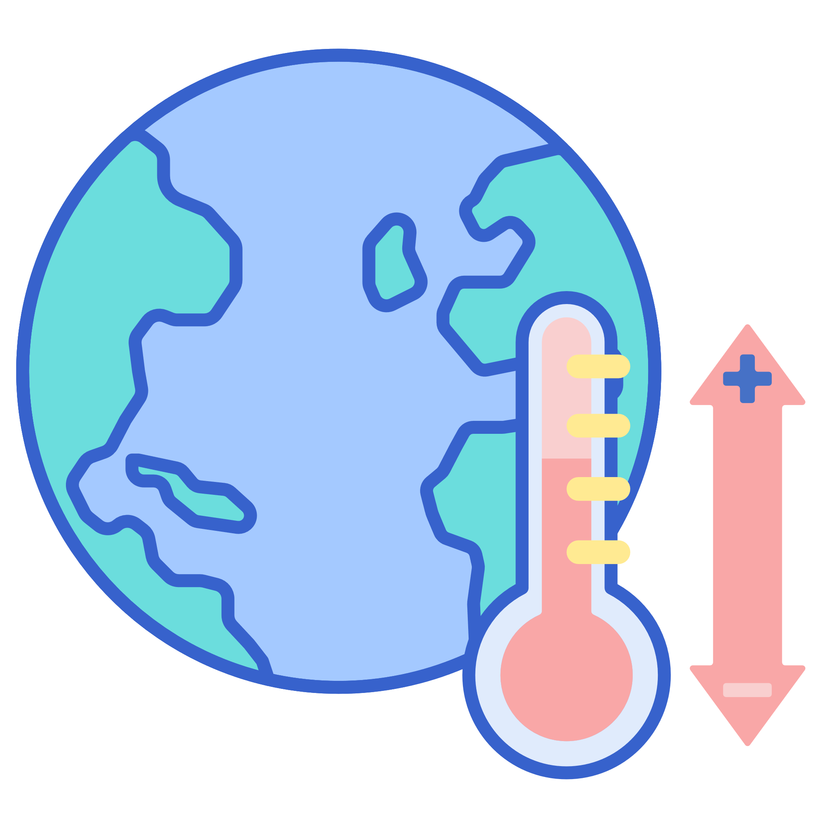

... and more concerns
Behavioral Pattern
Climate Change
Energy Trend
Home automation
Tenant Engagement
Climate Data
Gas to Electric
Solar panel
Notes:
Things to look at and incorporate more data for analysis
Research and understand user – to be able to sell the analytics and apps to them
A submeter and app to engage tenant with transparency to let them feel they can control
Paris agreement
New law and trend to replace gas with electric heater - more
European Union set a new legal framework called "Clean Energy for all Europeans“
Data and trends that we can incorporate into Power Management Program

Slide 11

Smart home - an investment
91%
of brokers said they
benefit from
smart home technology.
Safer
Cheaper
Easier
Smarter !
45%
American Smart homeowner saved an average of $1,100 per year through climate automation alone.
15%
saved on air-con bill,
12 % on heating bill
with smart thermostat.
Notes:
91.3% of brokers and agents said they would benefit from the incorporation of smart home technology into marketing of a home.
45% American Smart homeowner saved an average of $1,100 per year through climate automation alone in the home.
Safety and security. Energy efficiency. Comfort and convenience.
Smart home as a trend is the key for first time house buyers like millennials or generations after.
https://www.tiohome.com/tio-articles/financial-case-smart-home-can-home-automation-increase-homes-appraisal/
https://www.housingwire.com/articles/49925-smart-home-upgrades-that-raise-home-value/

Slide 12
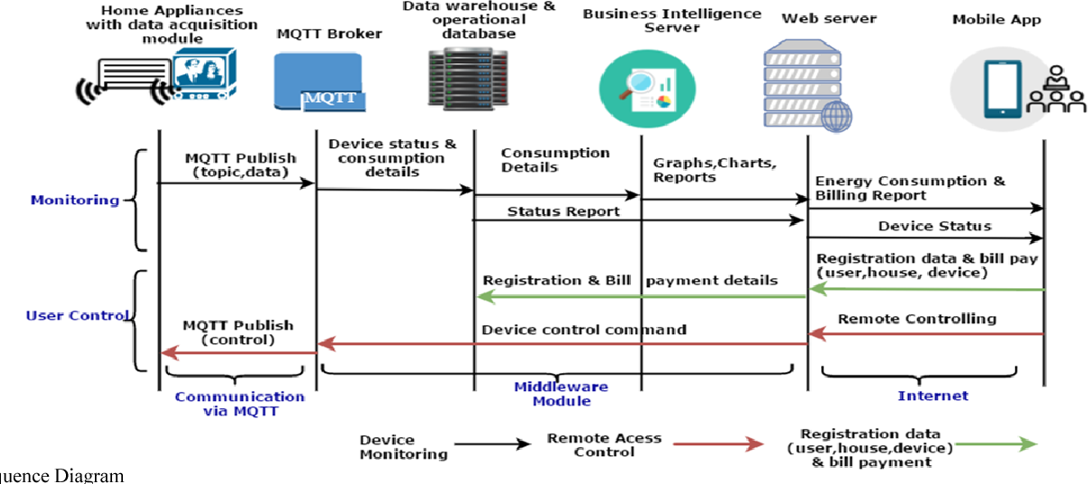
Smart home process
Encryption
IoT Analytics
User
Usage Analytics
Home Automation
Notes:
Transparent process
Power usage to give encrypted data to us.
Iot Analytics to gives report to users

Slide 13
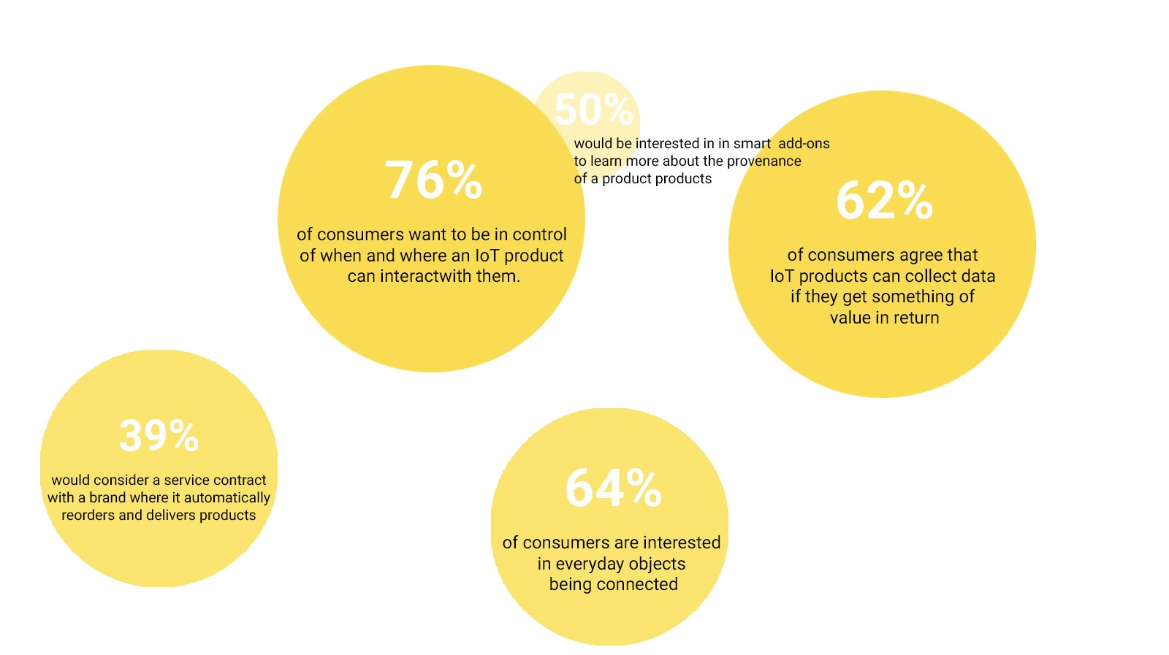
Data Management
GDPR compliant
Anonymous, encrypted data
Mutual understanding
Notes:
Data access attitude for IoT consumers
General Data Protection Regulation
62 % agree ioT products can collect data if they have value in return
Mutual understanding of the process and usage of data

Slide 14
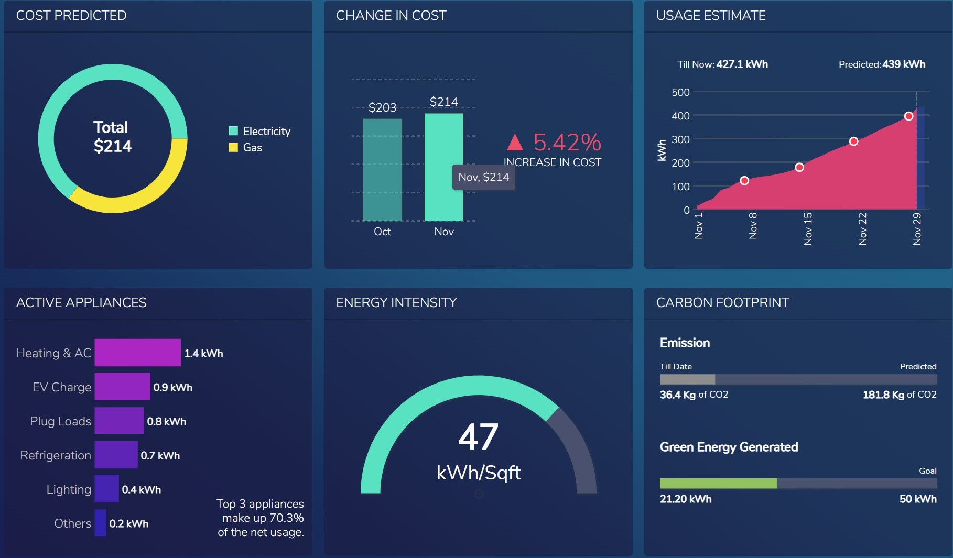
Smart home dashboard
Device command
Usage comparison
Payment fulfillment
U name it !
Notes:
Give estimations

Slide 15
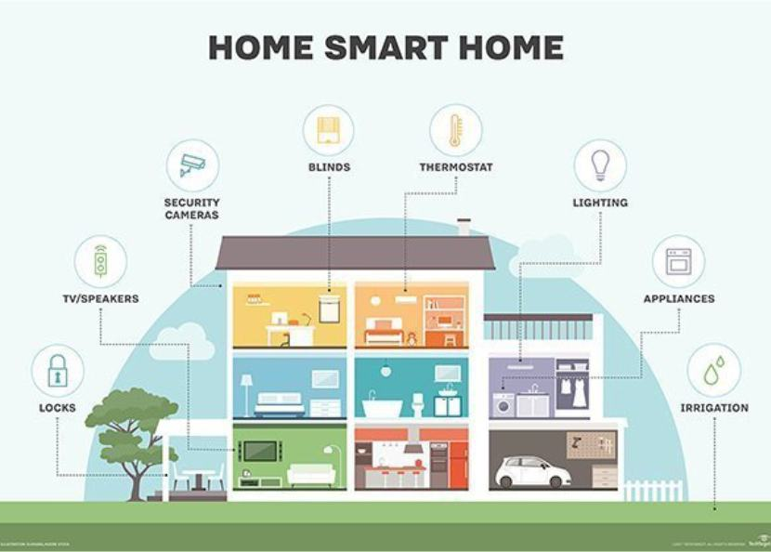
THANK YOU
Notes:
Many aspects to implement home automation
Home sweet home to home smart home \
Thank you !

Slide 16
Data Analysis & Power Management products

Slide 17
Agenda
Forecasting
Usage estimation
Weather forecasting
Bill prediction
Dashboard
Employ Shiny
Warning system
Appliance detection
Peak shifting – behavioral changes

Slide 18
Recap
Issues needed to be solved

Slide 19
Requirements
Any useful correlations or predictions you can glean from the data. If none can be found or if the relationships are weak, suggest other types of data you believe might be needed to improve the analysis
A summary statement that addresses the goal of this project. Has the goal been met?
Five business recommendations you can suggest based on your visualization and analysis of the power consumption data. Include justifications of your recommendations
One or more slides discussing lessons learned.

Slide 20
Generic suggestions
Insulation – home builder
Energy panel

Slide 21
Solving issues
ISSUE 1
Irregular Usage
Anomaly detection
Alarm misuse
ISSUE 2
Heating in peak hours
Peak Shifting as a recommendation
Readings for heating at sleeping room
Compare with the total to see if helps bring down the bill
Implement bill estimation to compare
Final step to integrate all into dashboard

Slide 22
Sub meter optimization
ISSUE 2
Fridge in Laundry room
Readings Per room
Thermometer installation
Smart plug integration to app

Slide 23
Library(highcharter)
Arima for trend -Holtwinter for seasonality
The suitable forecasting methods and the most suitable forecasting period were chosen by considering the smallest value of AIC (Akaike Information Criterion) and RMSE (Root Mean Square Error), respectively.
ARIMA model was the best model for finding the most suitable forecasting period in monthly and quarterly. On the other hand, ARMA model was the best model for finding the most suitable forecasting period in daily and weekly.
Suitable forecasting periods
Arma :28 days, 5 weeks
ARIMA: 6 months to 2 quarters.

Slide 24
missing values
April 28-29, 2007
Aug 2008
Address, complete cases with N/A (to be able to address later)
Time zone issue
Less then 1 % 180 (see if time efficient to do)
Use mean (week before + week after)
Interpolation of the two observations ( last min + first min)

Slide 25
Forecasting
Intervals ? Temp – weekly to see climate change
Predict of 27 Nov- 31 Dec 2010 (overfitting ???)
Use 2006-2010 data
Use 2010 Data
Use Nov 2010 data
Fix missing values
Predict of 2011- weekly/ monthly/quarterly
Use 2006-2010 data
Use 2010 data

Slide 26
Dashboard
Draw a board with spots
Link the data
Make interactive ?
Recommendations on external data
Design a spot on dashboard

Slide 27
Lesson learned
Strategy of product completion first
Dashboard design will influence how the dataframe structured
To save time on back and forth tuning data

